Slide 1
Raising a Reader and a Writer
Literacy Afternoon
January, 2015

Slide 2
What is writing?
Writing = Communication

Slide 3
Stages of Early Writing Development
Random Scribbling

Slide 4
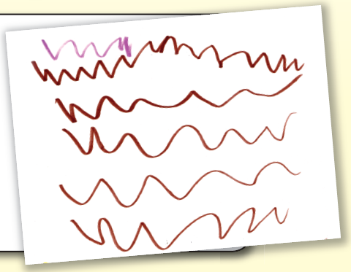
Stages of Early Writing Development
Controlled Scribbling

Slide 5
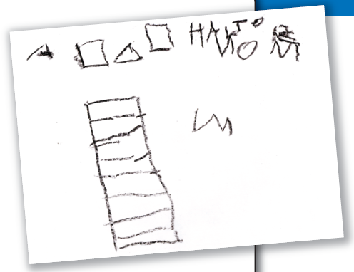
Stages of Early Writing Development
Mock Writing

Slide 6
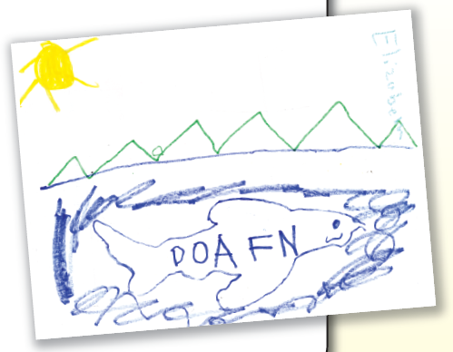
Stages of Early Writing Development
Writing Letters

Slide 7
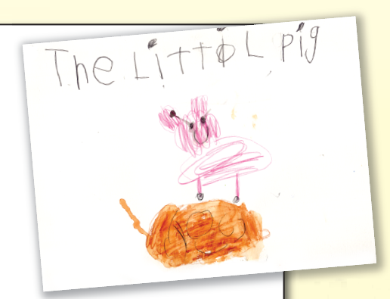
Stages of Early Writing Development
Writing Words

Slide 8
Pre-Writing Skills
Fine Motor Skills
- Help with meals (stir, shake, chop, mix, …)
- Feed themselves using forks and spoons
- Open and close containers with lids
- Cut a variety of materials with scissors
- Play with puppets, small blocks/Legos, puzzles
- Draw/write on a variety of surfaces with a variety of writing utensils
- Have fun lacing and beading
- Practice drawing

Slide 9
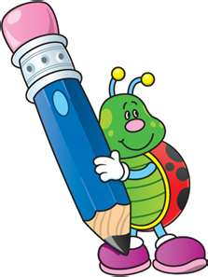
Pre-Writing Skills
Develop arm, hand and wrist strength
- Climb and play with playground equipment (especially monkey bars and climbing walls)
- Write on vertical surfaces
- Play with play-dough and knead dough for bread, cookies, crafts

Slide 10
Pre-Writing Skills
Eye and hand coordination
- Throw to a target (bowling, golf, basket, …)
- Sort things with tools (tongs or tweezers) or pour liquid/dry rice into containers.
- Tactile letters: practice finger tracing them.

Slide 11
Pre-Writing Skills
Pre writing letter awareness
- Make letters out of play-dough
- Make a sand or salt box and trace the letters
- Play games like memory, bingo, fishing, and letter hunts
- Read and point to the print
- Create a writing center at home (drawing and writing utensils, dry erase boards, tablets, etc.)

Slide 12
Pre-Writing Skills
Phonemic awareness
- Create nonsense words
- Clap/jump names/words, syllable hoops
- Finding things: initial phoneme
- Rhyme and alliteration games
- “I spy” game

Slide 13
Essential Tip:
Make writing MEANINGFUL:
Encourage your child to write
- grocery lists
- birthday/thank you/miss you/… cards
- stories/books to read to the family
- journals about recent experiences
Children are learners who will develop in their own rate and will need plenty of time to practice their skills.

Slide 14
Thank You!

