Slide 1
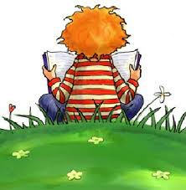
Raising a Reader and a Writer
Literacy Afternoon
January, 2015

Slide 2
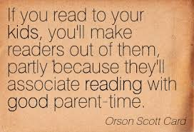
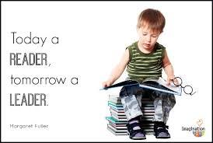
Pre-reading Skills
Before your child actually begins to read, he/she will develop a set of skills known as pre-reading skills. Many of these skills are learnt naturally, at home and in the nursery/preschool environment. By talking and reading with your child, you will be doing a great deal to help these essential skills to develop.

Slide 3
Tips for Reading with your Child
Build the best home library for your child.
The early years are critical to developing a lifelong love of reading.
Choose a good time and comfortable spot to read to your child.
Read together every day. Make it a routine.
Show your child that you are a good reader too!

Slide 4
Tips for Reading with your Child
Show your child the different parts of a book
Show how we read words on a page
Be interactive
Read it over and over again
Encourage creativity and understanding
Point out print everywhere

Slide 5
What you can do to help your child develop pre-reading skills?
1. Read, read, read, read, read!
There is no better way to introduce your child to language than to read to them daily.
2. Matching: When we read, part of what we do involves matching. Children learn to match shapes, patterns, letters and, finally, words.
Card games
Bingo games
Magnetic letters
Pairing up socks from the laundry
Jigsaw puzzles

Slide 6
What you can do to help your child develop pre-reading skills?
3. Rhyming: Research shows that children who can understand about rhyming words have a head start in learning to read and, even more, to spell.
Sing nursery rhymes
Miss of the end of rhymes for your child to complete, e.g. "Humpty Dumpty sat on a wall, Humpty Dumpty had a great...?"
When that gets too easy for them, make it harder! "Humpty Dumpty sat in a tree, Humpty Dumpty had a cup of ...?"
Play rhyming games such as "I Spy with my little eye, something that rhymes with fox" (box).
Encourage your child to sing along to nursery rhymes, pop songs, whatever they enjoy.

Slide 7
What you can do to help your child develop pre-reading skills?
4. Letter skills: As well as recognizing letter shapes, learning the most common sounds that each letter makes will give children a head start.
Introduce letters and their sounds gradually.
Start with letters that are important to your child, such as their initial, all those with an interesting shape which makes them easy to recognize.
Use letter sounds rather than names - 'a for ant', not 'ay for ape'. Letter sounds are much more useful in learning to read than names.
Generally, stick to lower case letters to start with, except for the first letter of a name.
Try using magnetic letters.

Slide 8
What you can do to help your child develop pre-reading skills?
5. Direction: Print goes from left to right, so children will need to be familiar with where to start each line and which direction to go in.
Your child won't need to know 'left' and 'right' in order to read - lots of adults still get mixed up!
When reading to your child, follow the print with your finger.
Later, you can ask them where you should start - try reading the words in reverse order, to demonstrate that the story doesn't make sense if you don't start in the right place.
Play activities which reinforce left-right direction, such as ask child to draw a line to take the bunny (on the left) to its hutch (on the right), transfer items from the left side to the right.

Slide 9
What you can do to help your child develop pre-reading skills?
6. Concepts of print: This is all about knowing how print and text “work”. Concepts of print include things such as:
We hold a book and we open it a certain way
Books have a front and a back cover, an author and an illustrator/photographer
It is print that we read and the illustrations are related to the print
Print represents language
There are many purposes for print
Words don’t change between readings
We read words from top to bottom and left to right, and we use “return sweep” (next line down we start from the left again)
Space separates words
Knowledge of punctuation, uppercase and lowercase letters

Slide 10
What you can do to help your child develop pre-reading skills?
7. Language skills:
The more experience children have of language, the more easily they will learn to read. Your child needs to hear and join in conversations (with adults and children), and listen to stories and poetry of all sorts.
Having conversations with your child about anything and everything is the best way to develop their language skills.
Reading stories to them will broaden their vocabulary.
Make sure that your child gets plenty of opportunity to talk to other adults and children.

Slide 11
The number one way to get young children on the road to reading is: Read together EVERY day!

Slide 12
Thank You!

